Slide 1
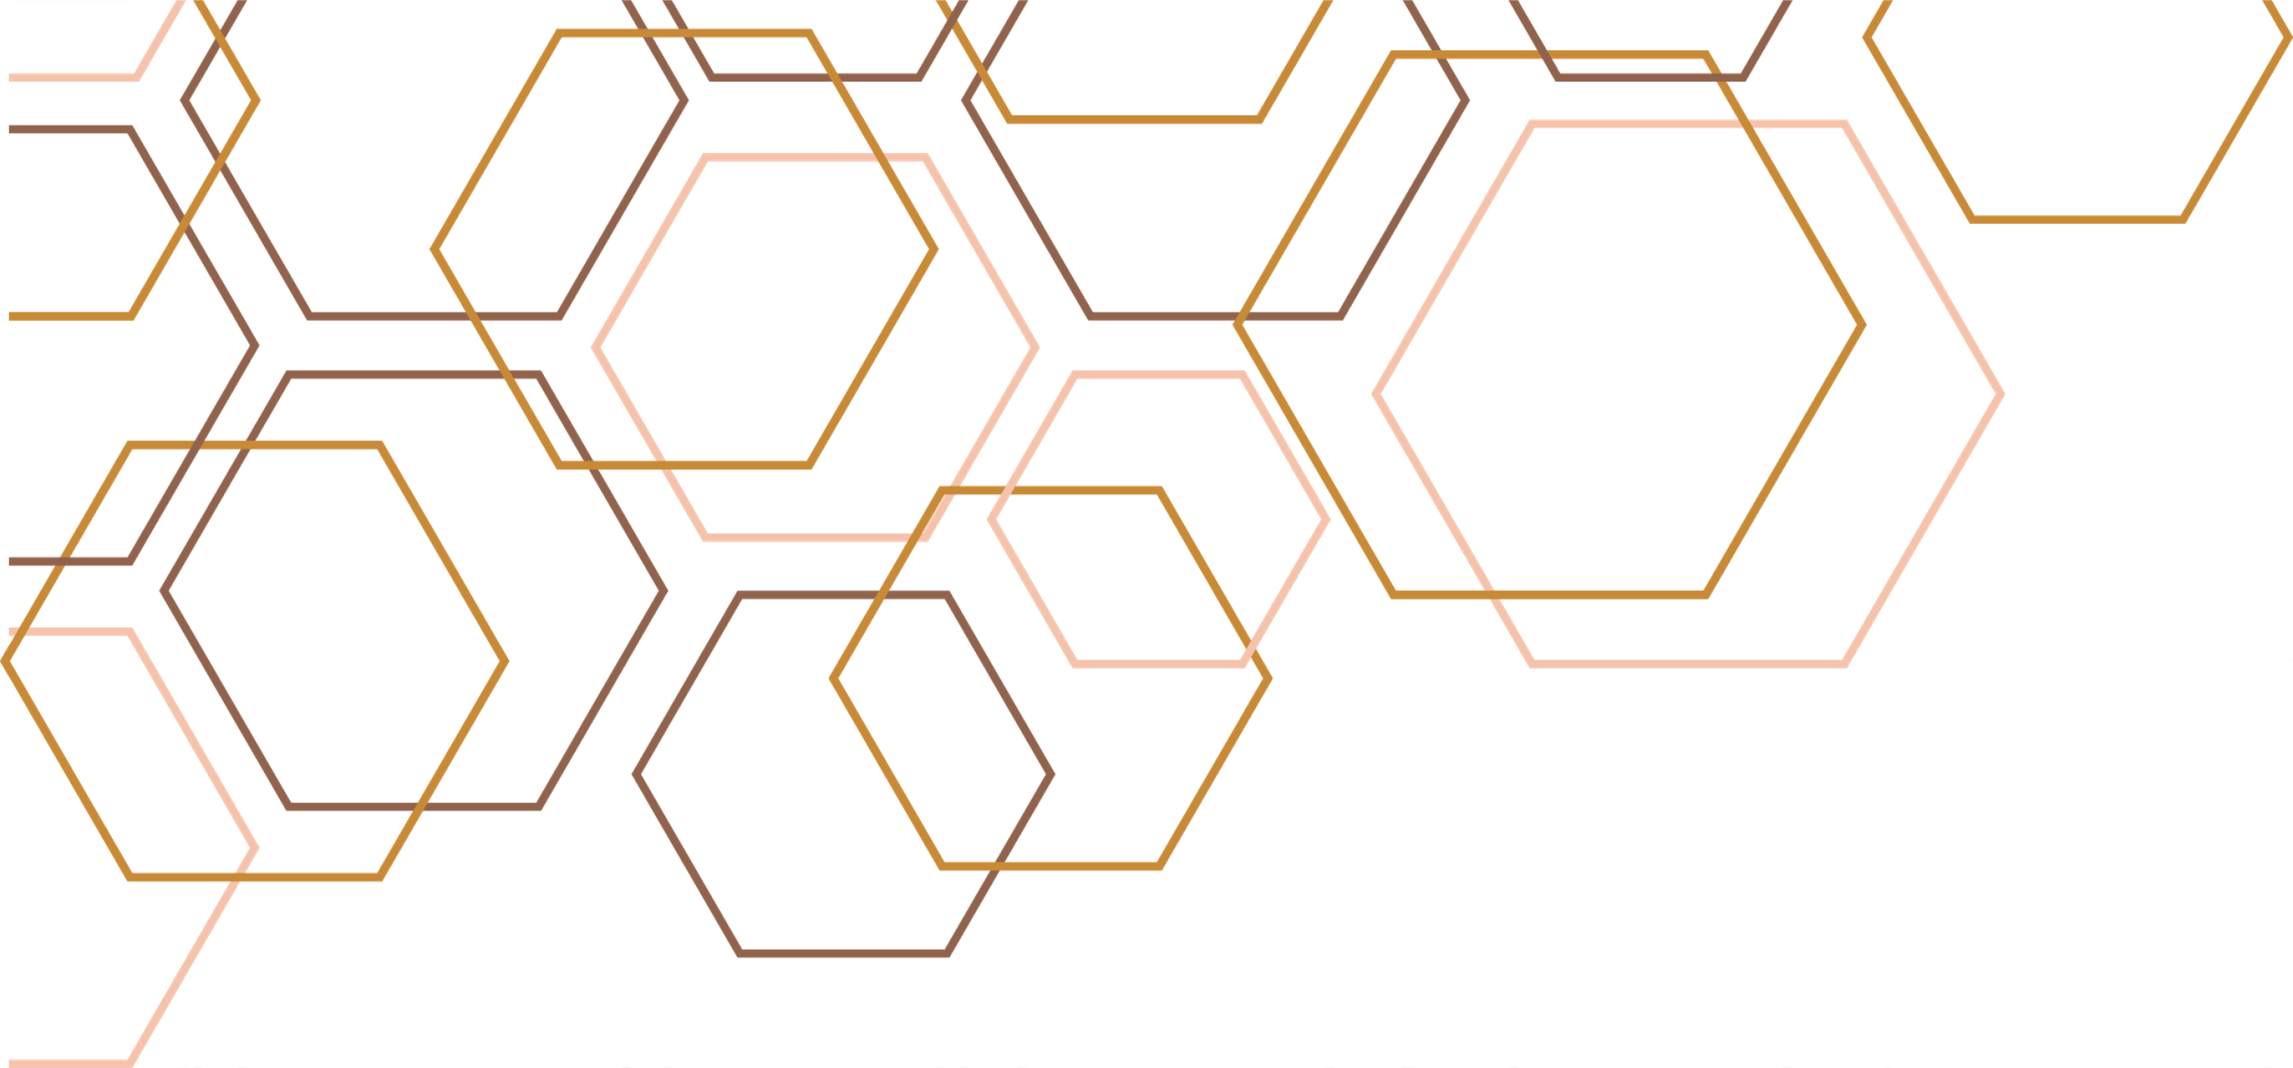

DATA ANALYSIS USING SPECTRAL CLUSTERING ALGORITHMS

Slide 2
Background
Retail analytics is becoming a critical aspect in terms of customer behaviour comprehension and efficient decision making.
Firms have been depending on clustering strategies to determine patterns in transactions and to cluster consumers or products.
Conventional algorithms, such as K-Means, are unsuccessful in case of non-linear and high dimensional data.
Spectral clustering is a type of graph-based method that may be used to record the sophisticated structures missed by the classical approaches.
This project aims at exploiting the spectral clustering to make observations in customer purchasing and product associations tendencies that lie hidden.
The strategy will provide information valuable in marketing, recommendations and optimisation of inventory.
Notes:
Retail analytics is a vital tool in assisting firms in studying purchase behaviour and revealing trends concealed in immense datasets. Conventional clustering algorithms like the K-Means have been extensively used, and frequently need to exhibit spherical clusters and therefore cannot cluster complex and sparse data like TXs in retail. Spectral clustering offers a graphical solution to clustering and in this regard, it has a big advantage because it enables non-linear and non- travels to be identified or rather detected. This brings it closer to real-world retail data with different types of customer preferences, and product relationships. Through spectral clustering mechanisms, the project is aimed at enhancing segmentation, targeted marketing and the grouping of products.

Slide 3
Problem Definition
  The project deals with the difficulty of finding hidden trends in the data on the retail transactions.
  Retail data can be non-linear, high-dimensional and sparse and cannot be effectively clustered with off-the-shelf algorithms.
  It is all directed towards segmenting the customers depending on their purchasing behaviour in order to enhance the targeted marketing technique.
  Another goal is product grouping where popular products can be grouped to aid in cross selling with management benefits in terms of inventory.
  The support of recommendations will be improved with means of defining meaningful customer-product relationships.
  Spectral clustering is appropriate as this method of clustering makes use of similarity graphs and Laplacian matrices in order to display non-convex clusters.
Notes:
The central issue known here is that the concealed patterns within the retail transactions that are commonly ignored by standard clustering process need to be revealed when addressing this issue through this project. Retail data tends to be high dimensional and sparse and the relationships among the products and customers are complex and non-linear. Such complications render methods such as the K-Means less useful, since they assume uncomplicated convex cluster models. The project hence is customer segmentation-oriented project, product grouping oriented, and recommendation supporting project. It is possible to cluster non-convex clusters of the data by using spectral clustering that uses graph-based measures of similarity to capture clusters, which allows more interpretive information. These are the remedies that can be accomplished with the improvement of targeted marketing, customer loyalty, and product bundling and inventory planning.

Slide 4
Aim
  Aim
  1. To apply spectral clustering algorithms on retail transaction data and evaluate their performance in uncovering hidden patterns.
  2. To compare spectral clustering with alternative methods such as K-Means and Agglomerative Clustering, assessing advantages and limitations.
  3. To provide actionable business insights in customer segmentation and product relationship analysis, supporting applications like recommendations and inventory management.
  4. To design and develop a Flask-based web portal that provides an interactive interface for uploading data, running clustering algorithms, and visualising results.
Notes:
The main goal of this project is to serve the retail transaction data by the spectral clustering algorithms and determine the power of these algorithms to hint at the concealed patterns. In parallel to this, the project compares spectral clustering with principle baseline (K-means, Agglomerative clustering) approaches and their pros and cons. Deriving actionable business insights such as recommendations and inventory management are other achieved objectives through customer segmentation, product relationship analysis. Lastly, the project will aim to design and implement an interactive web portal based on Flask, which will allow users to post datasets on the portal, use clustering methods, and visualise the results, to make well-informed decisions.

Slide 5
Requirements
  Requirements
  1. Data Preprocessing: Clean and process the dataset through the manipulation of missing values, duplicate values and invalid transactions.
  2. Similarity Matrix Construction: Construct customer-product as well as product co-occurrence similarity matrices based on similarity measures like the cosine similarity or the Euclidean distance.
  3. Clustering Implementation: Spectral Clustering, K-Means and Agglomerative Clustering are implemented on the data.
  4. Evaluation Metrics: Evaluate quality of clustering by silhouette index, Davies-Bouldin index, and graphical coherence explorations.
  5. Visualisation: Dimension reduction by PCA and visualizations of clusters by t-SNE.
  6. Flask-Based Web Portal: Develop a user-friendly interface for data upload, algorithm selection, and visualisation of clustering results.
  7. Insight Generation: Build business-related deliverables like customer segmentation, product group and possible recommendations.
Notes:
The project requirements are in a way designed to make sure that they are properly implemented and used practically. These are: first, the dataset has to be preprocessed, so as to exclude missing values, duplicates, and invalid records. Secondly, customer-product interaction and product co-occurrence similarity matrices are created using the cosine, Jaccard and Euclidean distance. Spectral clustering, the K-Means method, as well as Agglomerative are all a part of Clustering. Assessment is based on in-house performance such as Silhouette, Davies-Bouldin, and visual assessment through use of PCA and t-SNE. An interaction web portal is designed as based on Flask, allowing the user to interact, choose algorithms, and visualise. Lastly, the system drives insight into customer segmentation, product grouping, and recommending certain action steps.

Slide 6
Hypotheses
  The project will test the following hypotheses:
  Spectral clustering will outperform K-Means in identifying non-convex clusters in retail datasets.
  Graph-based similarity (cosine/Jaccard) will provide more stable and meaningful clusters than Euclidean distance in sparse retail data.
  These hypotheses provide a framework for structured evaluation and critical comparison.
Notes:
The hypotheses provided in the given project direct the assessment and provide a systematic manner of investigating. The former is simply a hypothesis that spectral clustering will be more effective than K-Means the latter in detecting non-convex clusters of retail data because K-Means should have spherical clusters. The second hypothesis is that graph-based measures of similarity like the cosine and the Jaccard measures that will present more substantial and consistent clusters than the EUclidean distance which is not efficient with sparse transaction data. Collectively, these hypotheses formed a basis of comparative systematics, guaranteeing the quality of evaluation both at algorithmic output and similarity measure, as far as retail analytics is concerned.

Slide 7
Algorithm Overview
Spectral clustering builds a similarity graph, calculates the Laplacian and applies eigenvalues to perform a clustering.
The advantages are that it can deal with non-linear and non-convex clusters, and in similarity measures allow flexibility.
Disadvantages of the technique are increased computing expense and dependence on the similarity measure.
K-Means are quick and easy to cluster though it is weak with sparse and bifurcated data.
Agglomerative is a type that forms hierarchy of plane clusters, though is computationally demanding with huge amounts of data.
Measures of similarity adopted: Cosine when the information is sparse, Jaccard when the data is binary, and the Euclidean when the data is continuous.
Notes:
This slide gives a summary of the algorithms of clustering on the project. The spectral clustering algorithm operates by creating a graph of similarities between the data and calculating the graph Laplacian, to reveal latent structures, and thus it is very effective with non-linear and complicated information. It gives stronger clusters, but may also be costly to compute and parameter fussy. K-Means and the Agglomerative clustering are used as baselines. K-Means both efficient and popular which is not suitable in non-spherical clusters and Agglomerative clustering that builds a hierarchical structure with inability to scale. To justify these algorithms, various measures of similarity are applicable to the data, which are Cosine, Jaccard and Euclidean measures, depending on the features of data.

Slide 8
Dataset Description
  The dataset that is used in the project is Online Retail II which is present on Kaggle.
  It holds the transaction records of more than 1 million transactions of an online retailer in the UK over a period of 2009-2011.
  It covers the features of invoice number, stock code, description of the product, the quantity, price, customer ID and country.
  This is anonymised data, so no sensitive or personally identifiable data was utilised.
  It facilitates the customer-oriented and product-oriented clustering.
  Its size and descriptive properties qualifies it to be applicable in studying the purchasing behaviour and associations with products.
Notes:
The dataset involved in this project is Online Retail II dataset, which is a massive amount of transactions of an online customer dealing with a retail outlet based in the UK in the period between 2009 and 2011. It contains more than one million records with elegant feature of invoice numbers and stock codes, product description, quantities, unit prices and customer identifiers and country recorded. Notably, it is completely anonymised, therefore, no sensitive or personal information used, which is why it is ethically safe to apply. Its broad scope enables it to be segmented by customers as well as to have product co-occurrence analysis. This renders it suitable in using spectral clustering in order to identify the latent purchasing behavior and relationship of products.

Slide 9
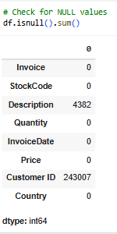
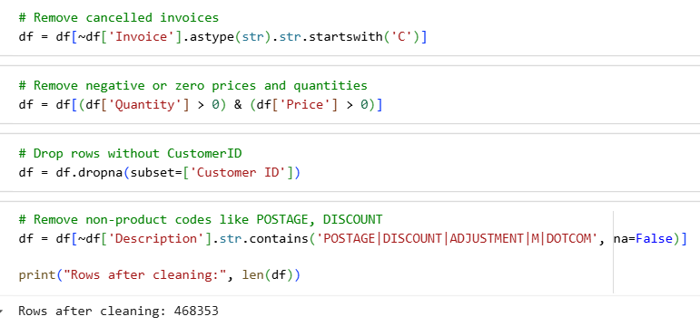
Data Exploration and Pre-Processing
The preliminary data analysis indicated that information on the important fields was missing especially in Description and Customer ID.
The percentage of missing records in the table were found to be at 4,382 in the field of Description and it was 243, 007 in the unaccounted records in Customer ID field.
Zero record and payments were removed because of cancelled invoices and records with negative and zero quantities and prices.
Filtering keywords in the description field allowed non-products entries to be filtered out.
These cleaning processes removed all invalid and meaningless retail transactions out of the dataset.
Following the preprocessing, the dataset was narrowed down to 468, 353 high-quality rows to be used in the clustering learning.
Notes:
The preprocessing step proved essential in making the data more accurate prior to running clustering algorithms. Early experimentation showed that the majority of the columns were filled in, although 4,382 values were missing in the Description field and that the Customer ID field had quite a number of missing just under 243,007. These holes had to be closed in order to provide consistency in clustering. The invoices and entries that were cancelled as well as those of negative amounts and no prices, were also removed and they added inaccuracies. Also, there were non-products entries like administrative entries or blank entries and filtered by keyword in description field. Following these directions, a dataset was cleansed and narrowed down to 468,353 records that were valid and to be analyzed.

Slide 10
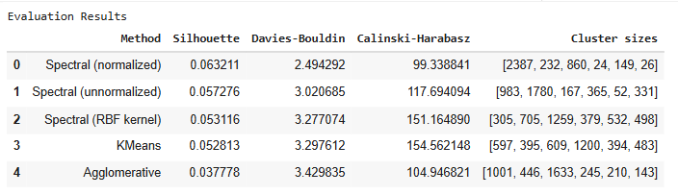
Results and Evaluation
  Silhouette, Davies-Bouldin and Calinski-Harabasz evaluations were applied to evaluate five clustering methods.
  The greatest Calinski-Harabasz of 151.16 with spectral clustering was performed with RBF kernel as it provided a better cluster separation.
  K-Means, and Agglomerative among others performed averagely across the measures.
  The scores of silhouette expressed variance in intra-cluster cohesion and inter -cluster separation.
  The values of Davies-Bouldin depict the closeness of the clusters and the smaller they are, the more desirable the clustering.
  Methods also differ in terms of size of clusters, and there is evidence that certain algorithms form more balanced clusters compared to others.
Notes:
The analysis was done through the performance of 5 clustering algorithms with three established measures of Silhouette, Davies-Bouldin as well as Calinski-Harabasz. Spectral clustering using RBF as a kernel showed better cluster separation with the highest Calinski-Harabasz score of 151.16 that depict clusters with strong delineation. The idea of silhouette scores offered the information about the cohesion in clusters, and the Davies-Bouldin scores indicate the proximity and segregation of clusters, so the smaller values the better. In all metrics K-Means and Agglomerative gave moderate results. Furthermore, the cluster sizes in all the methods differed, showing variations in the distribution of the data points in the algorithms. All of these findings lead to a decision on the best clustering approach to use.

Slide 11
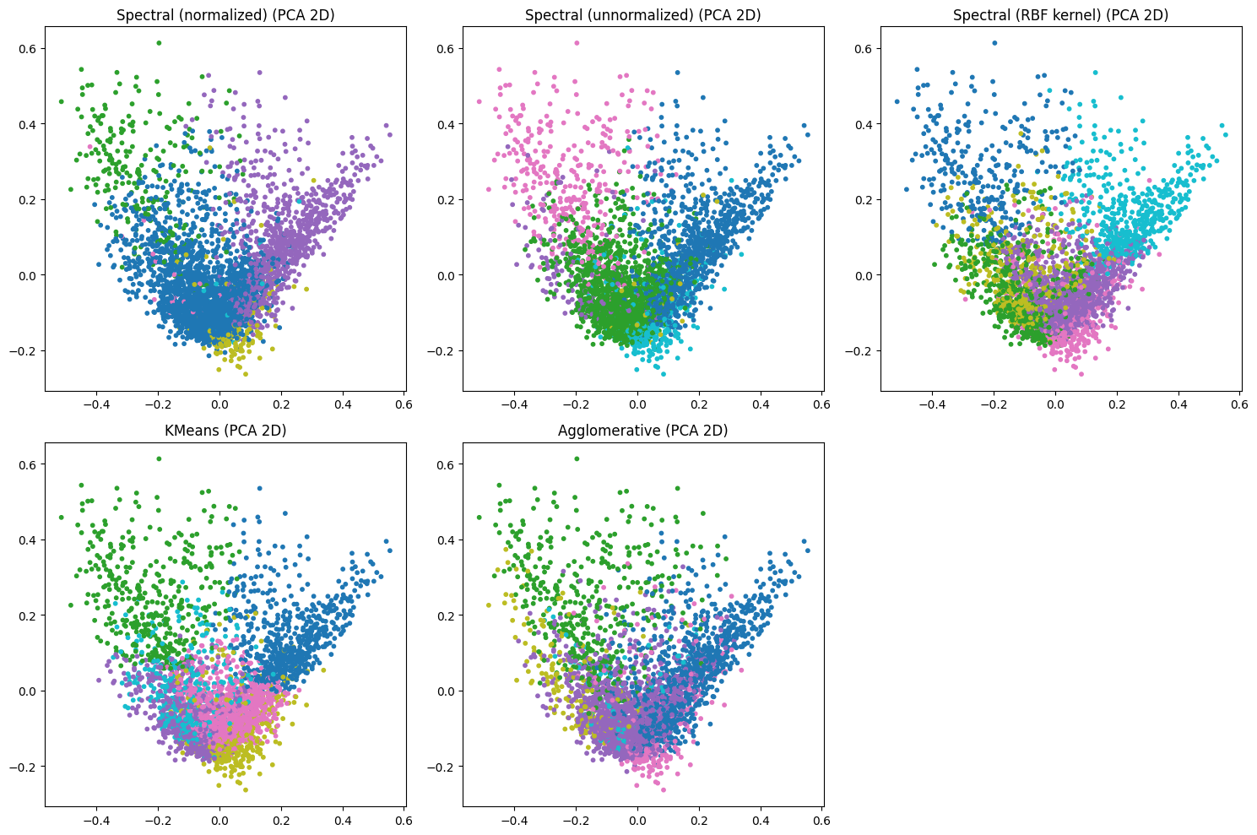
Visualisation
Notes:
This slide gives an important visual evaluation of the clustering process by reducing the multidimensional data to 2 dimensional plane through PCA. The resulting cluster assignments can be viewed of each of the five tested methods Spectral (normalized, unnormalized, RBF kernel), KMeans and Agglomerative. This would be best sought in plots wherein the colored groups are densely concentrated and markedly out of each other, and signal flowers of high-quality, definately select customer areas. Nevertheless, the visualization reveals a high level of overlap between all of the methods, implying that the structure of the customer data is not that dispassionate but is of a continuous nature. The RBF kernel of the Spectral method does marginally separate visually better than the rest, which can be apportioned to its positive metric scores in the last step, but in general, it confirms that the specified customer groups are highly intermingled.

Slide 12
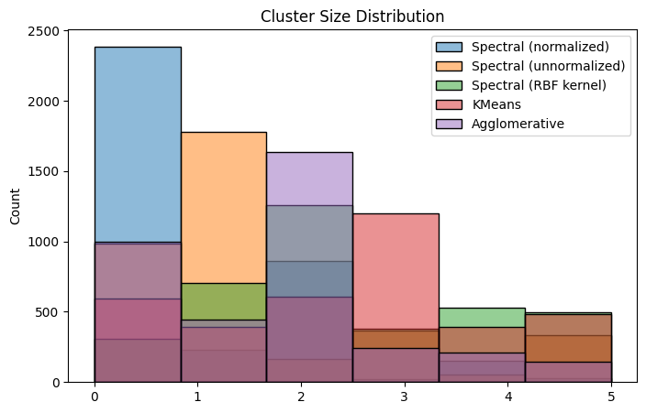
Visualisation
  This piled histogram compares used cluster sizes distribution of the five algorisms of clustering that were used.
  The x-axis is the cluster index (0 to 5) whereas the y-axis is the amount of data in that cluster.
  It seems that all the five methods have produced a group of very unevenly-sized clusters, as the tail of the first few bins is exceptionally tall.
Notes:
The distribution of the clustering sizes of the five algorithms are presented in a quantitative visual manner in this slide. The histogram is layered, i.e. the sum of the heights of individual bin represents the maximum cluster size of that index in any method. The most important lesson is the enormous imbalance of cluster size of all methods tested. As an example, in the Spectral (normalized) algorithm, the significant majority of data is assigned to the first cluster (Cluster 0) that is an issue in real world data where a significant section of the population would behave in a similar fashion. Although the Agglomerative clustering tends to distribute its data points somewhat more uniformly in the cluster indices, the visual data show that none of the techniques had laid laid 6 customer segments balanced on equal terms. This must be taken into consideration when using the interpretation of the customer profiles based on these clusters.

Slide 13
Conclusion
  Spectral clustering was found to have great power in revealing conveyable and complicated store information tendency.
  Measures of evaluation established that it was superior in separating clusters in a manner that was superior to that of K-Means and Agglomerative.
  Retail transaction data preprocessing offered a better quality of data resulting in a better quality of clustering.
  Findings point to possible this one is used in customer segmentation, product-grouping and recommendation.
  Spectral clustering was more appropriate in retrieving useful insights to retail analytics regardless of computational complexity.
  The research can be used to enhance the data-driven decision making in marketing and optimization of inventory.
Notes:
The findings made in the study conclude that spectral clustering is such an effective method of analyzing intricate and high dimensional retail data. In contrast to classical algorithms, it was able to grasp non-linear trends and to give better results in various performance measures. The preprocessing stage played a significant role to upgrade the quality of the dataset, which directly impacted the stability of the result of clustering. The findings have been applied in segmentation of customers, grouping products and recommendation systems, which give useful ideas on business strategy. Though, spectral clustering has limitations, its benefits supersede these constraints as it does demand more computational resources than the rest. In general, the project supports the significance of the state-of-the-art clustering procedures in contemporary retail analytics.

Slide 14
Thank you

